Slide 1

SECA4002 – DEEP LEARNING NEURAL NETWORKS
Dr. V. Vedanarayanan B.E., M.E., PhD
Course Co-ordinator
Assistant Professor, Department of ECE,
School of Electrical and Electronics
SATHYABAMA INSTITUTE OF SCIENCE AND TECHNOLOGY

Slide 2

Course Outcomes
SECA4002 – DEEP LEARNING NEURAL NETWORKS
At The end of this Course, Student will be able to
CO1 | Select suitable model parameters for different machine learning techniques
CO2 | Evaluate the performance of existing deep learning models for various applications
CO3 | Realign high dimensional data using reduction techniques
CO4 | Analyze the performance of various optimization and generalization techniques in deep learning
CO5 | Modify the existing architectures for domain specific applications
CO6 | Develop a real time application using deep learning neural networks

Slide 3
Course Objectives
SECA4002 – DEEP LEARNING NEURAL NETWORKS
Course Objectives:
To present the mathematical, statistical and computational challenges of building neural networks
To study the concepts of deep learning
To introduce dimensionality reduction techniques
To enable the students to know deep learning techniques to support real-time applications
To examine the case studies of deep learning techniques

Slide 4
SECA4002 – DEEP LEARNING NEURAL NETWORKS
Detailed Syllabus:
UNIT 2: DEEP NETWORKS
History of Deep Learning- A Probabilistic Theory of Deep Learning- Backpropagation and regularization, batch normalization- VC Dimension and Neural Nets-Deep Vs Shallow Networks Convolutional Networks- Generative Adversarial Networks (GAN), Semi-supervised Learning

Slide 5
SECA4002 – DEEP LEARNING NEURAL NETWORKS
Recommended Text Books/ Reference Books
Cosma Rohilla Shalizi, Advanced Data Analysis from an Elementary Point of View, 2015.
Deng & Yu, Deep Learning: Methods and Applications, Now Publishers, 2013.
Ian Goodfellow, Yoshua Bengio, Aaron Courville, Deep Learning, MIT Press, 2016.
Michael Nielsen, Neural Networks and Deep Learning, Determination Press, 2015.

Slide 6
SECA4002 – DEEP LEARNING NEURAL NETWORKS
Detailed Syllabus:
UNIT 2: DEEP NETWORKS
History of Deep Learning- A Probabilistic Theory of Deep Learning- Backpropagation and regularization, batch normalization- VC Dimension and Neural Nets-Deep Vs Shallow Networks Convolutional Networks- Generative Adversarial Networks (GAN), Semi-supervised Learning

Slide 7
Deep Learning - History
The chain rule that underlies the back-propagation algorithm was invented in the seventeenth century (Leibniz, 1676; L’Hôpital, 1696)
Beginning in the 1940s, the function approximation techniques were used to motivate machine learning models such as the perceptron
The earliest models were based on linear models. Critics including Marvin Minsky pointed out several of the flaws of the linear model family, such as its inability to learn the XOR function, which led to a backlash against the entire neural network approach
Efficient applications of the chain rule based on dynamic programming began to appear in the 1960s and 1970s
Werbos (1981) proposed applying chain rule techniques for training artificial neural networks. The idea was finally developed in practice after being independently rediscovered in different ways (LeCun, 1985; Parker, 1985; Rumelhart et al., 1986a)
Following the success of back-propagation, neural network research gained popularity and reached a peak in the early 1990s. Afterwards, other machine learning techniques became more popular until the modern deep learning renaissance that began in 2006
The core ideas behind modern feedforward networks have not changed substantially since the 1980s. The same back-propagation algorithm and the same approaches to gradient descent are still in use.

Slide 8
Deep Learning - History
Most of the improvement in neural network performance from 1986 to 2015 can be attributed to two factors. First, larger datasets have reduced the degree to which statistical generalization is a challenge for neural networks. Second, neural networks have become much larger, because of more powerful computers and better software infrastructure.
A small number of algorithmic changes have also improved the performance of neural networks noticeably. One of these algorithmic changes was the replacement of mean squared error with the cross-entropy family of loss functions. Mean squared error was popular in the 1980s and 1990s but was gradually replaced by cross-entropy losses and the principle of maximum likelihood as ideas spread between the statistics community and the machine learning community.
The other major algorithmic change that has greatly improved the performance of feedforward networks was the replacement of sigmoid hidden units with piecewise linear hidden units, such as rectified linear units. Rectification using the max{0, z} function was introduced in early neural network models and dates back at least as far as the Cognitron and Neo-Cognitron (Fukushima, 1975, 1980).
For small datasets, Jarrett et al. (2009) observed that using rectifying nonlinearities is even more important than learning the weights of the hidden layers. Random weights are sufficient to propagate useful information through a rectified linear network, enabling the classifier layer at the top to learn how to map different feature vectors to class identities. When more data is available, learning begins to extract enough useful knowledge to exceed the performance of randomly chosen parameters. Glorot et al. (2011a) showed that learning is far easier in deep rectified linear networks than in deep networks that have curvature or two-sided saturation in their activation functions.

Slide 9
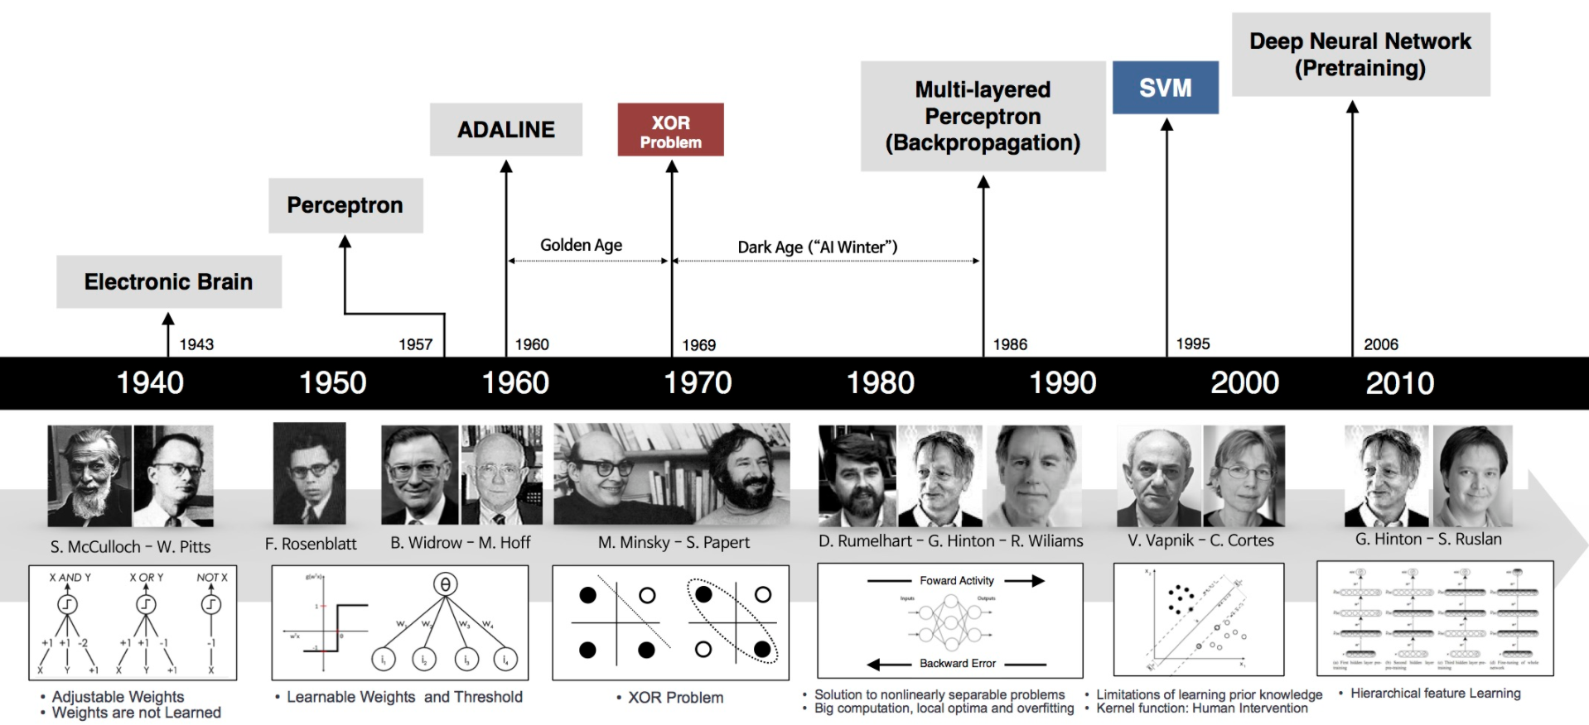
Deep Learning - History
When the modern resurgence of deep learning began in 2006, feedforward networks continued to have a bad reputation. From about 2006 to 2012, it was widely believed that feedforward networks would not perform well unless they were assisted by other models, such as probabilistic models. Today, it is now known that with the right resources and engineering practices, feedforward networks perform very well. Today, gradient-based learning in feedforward networks is used as a tool to develop probabilistic models.
Feedforward networks continue to have unfulfilled potential. In the future, we expect they will be applied to many more tasks, and that advances in optimization algorithms and model design will improve their performance even further
nn_timeline.jpg (2133×1002) (beamandrew.github.io))

Slide 10
SECA4002 – DEEP LEARNING NEURAL NETWORKS
Detailed Syllabus:
UNIT 2: DEEP NETWORKS
History of Deep Learning- A Probabilistic Theory of Deep Learning- Backpropagation and regularization, batch normalization- VC Dimension and Neural Nets-Deep Vs Shallow Networks Convolutional Networks- Generative Adversarial Networks (GAN), Semi-supervised Learning

Slide 11
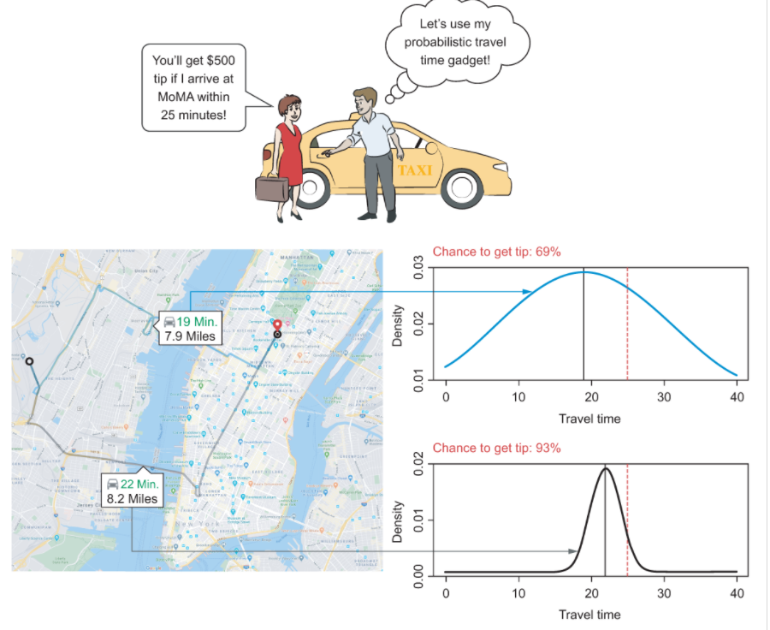
Deep Learning – Probabilistic Theory
Probability is the science of quantifying uncertain things.
Most of machine learning and deep learning systems utilize a lot of data to learn about patterns in the data.
Whenever data is utilized in a system rather than sole logic, uncertainty grows up and whenever uncertainty
grows up, probability becomes relevant.
By introducing probability to a deep learning system, we introduce common sense to the system
In deep learning, several models like Bayesian models, probabilistic graphical models, Hidden Markov models
are used. They depend entirely on probability concepts.
Real world data is chaotic. Since deep learning systems utilize real world data, they require a tool to handle the chaoticness.
https://www.manning.com/books/probabilistic-deep-learning

Slide 12
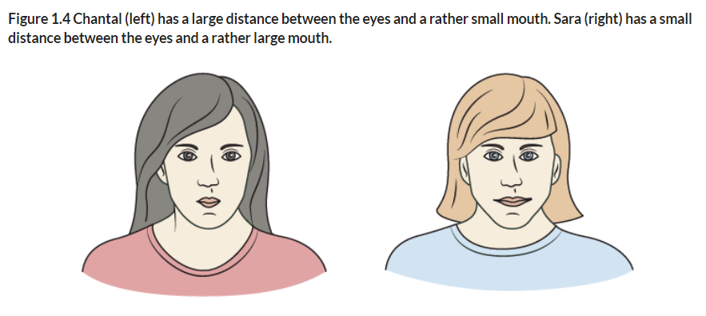
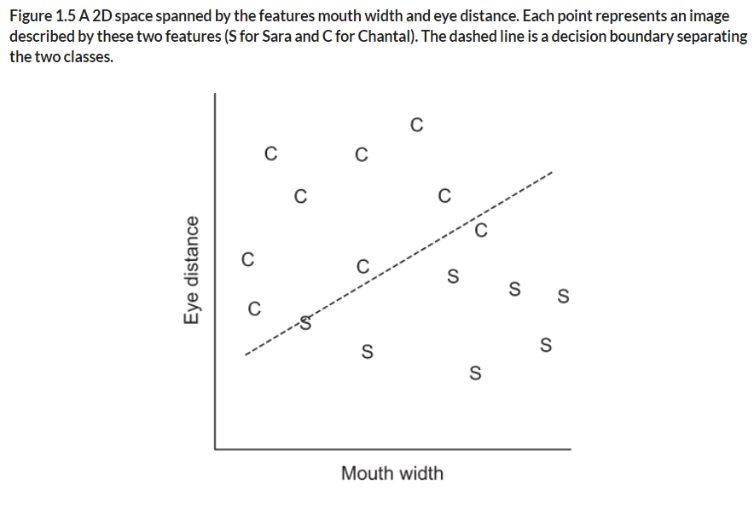
Deep Learning – Probabilistic Theory
https://www.manning.com/books/probabilistic-deep-learning

Slide 13

Deep Learning – Probabilistic Theory
https://www.manning.com/books/probabilistic-deep-learning

Slide 14
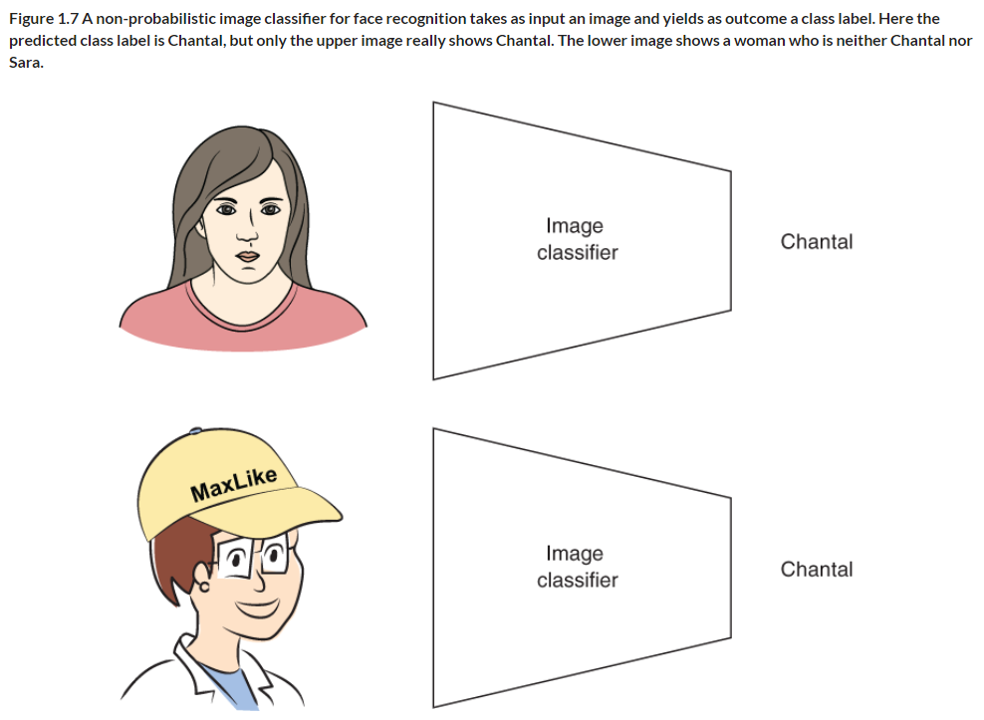
Deep Learning – Probabilistic Theory
Non- Probabilistic Classifier
https://www.manning.com/books/probabilistic-deep-learning

Slide 15
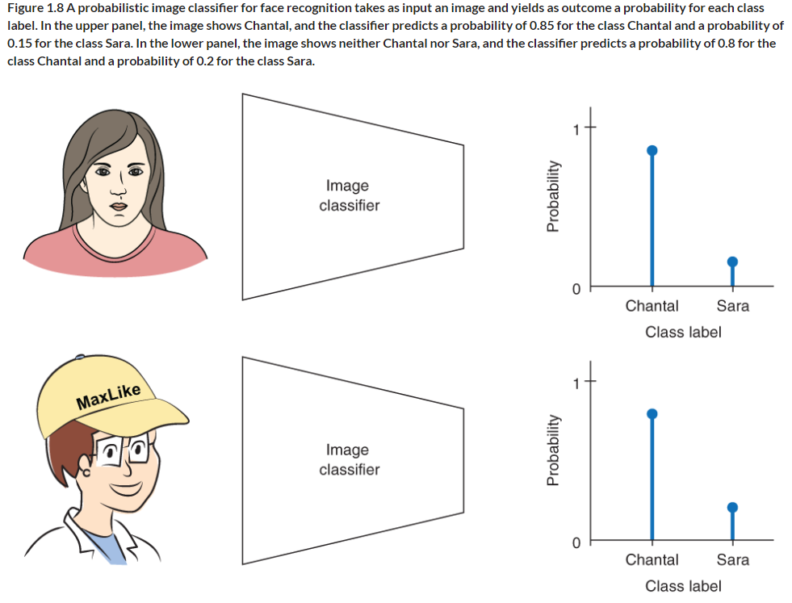
Deep Learning – Probabilistic Theory
Probabilistic Classifier
https://www.manning.com/books/probabilistic-deep-learning

Slide 16
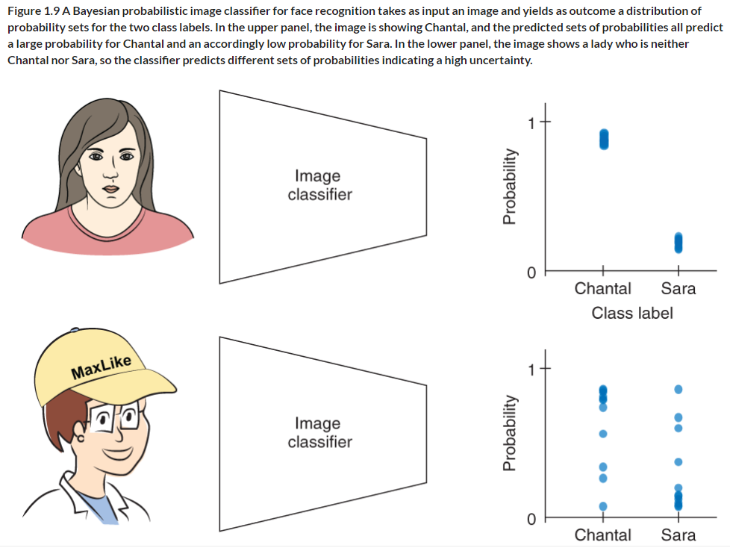
Deep Learning – Probabilistic Theory
Bayesian
Probabilistic Classifier
https://www.manning.com/books/probabilistic-deep-learning

Slide 17
SECA4002 – DEEP LEARNING NEURAL NETWORKS
Detailed Syllabus:
UNIT 2: DEEP NETWORKS
History of Deep Learning- A Probabilistic Theory of Deep Learning- Backpropagation and regularization, batch normalization- VC Dimension and Neural Nets-Deep Vs Shallow Networks Convolutional Networks- Generative Adversarial Networks (GAN), Semi-supervised Learning

Slide 18
Back Propagation Networks [BPN]
Introduced by Rumelhart, Hinton, & Williams in 1986
Multi layer Feedforward Network but error is back propagated, Hence the name Back Propagation Network (BPN)
Uses Supervised Training process
Systematic procedure for training the network is used
For Error Detection and Correction Generalized Delta Law /Continuous Perceptron Law/ Gradient Descent Law is used
Generalized Delta rule minimizes the mean squared error of the output calculated from the output
Training by backpropagation involves three (3) stages
1. Feedforward of input training pair
2. Calculation and backpropagation of associated error
3. Adjustments of weights
Different variants of BPN are available for increasing the training speed of the network

Slide 19
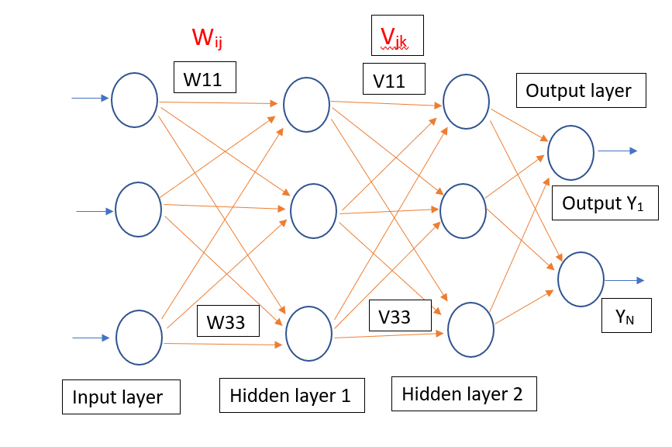
Back Propagation Networks [BPN]- Architecture
Weights between Input and Hidden Layer 1 is denoted as W_{IJ}
Weights between Hidden Layer 1 and Hidden Layer 2 is denoted as Vjk

Slide 20

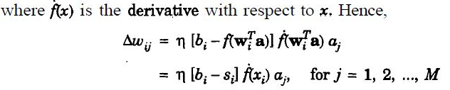
Delta Learning Law
Also known as Continuous perceptron Law ,Gradient Descent Law,
Supervised Training Law
Note:
Valid only for Differential Output functions ,since weight change depends on the derivative of output function
Supervised Training Law because change in weight is the difference between the Desired and Actual output (Error value)

Slide 21
Delta Learning Law
Faster convergence rate when compared with Perceptron Law
Extended version of Perceptron Training Law
Used to calculate the local minima point
Learning rate is taken in the range of 0.1 to 1
Limitations:
Network is slow for large data sets
Convergence time is more
Issues of Local minima
Temporal instability

Slide 22
Back Propagation Networks [BPN]- Algorithm
The training algorithm of BPN can be divided as
Initialization of Bias, Weights
Feedforward process
Back Propagation of Errors
Updating of weights & biases
Terms Used:
t – output Target Vector
X – Input Training vector
δ_{k} – Error at output unit Y_{k}
δ_{j} – Error at Hidden unit Z_{j}
α- Learning Rate
Voj- Bias on hidden unit j
Z_{j} – Hidden Unit j
Wok- Bias on Output unit k
Yk- Output unit K

Slide 23
Back Propagation Networks [BPN]- Algorithm
Algorithm:
I. Initialization of weights:
Step 1: Initialize the weights to small random values near zero
Step 2: While stop condition is false , Do steps 3 to 10
Step 3: For each training pair do steps 4 to 9
II. Feed forward of inputs
Step 4: Each input xi is received and forwarded to higher layers (next hidden)
Step 5: Hidden unit sums its weighted inputs as follows
Z_{inj} = W_{oj} + Σx_{i}w_{ij}
Applying Activation function
Z_{j} = f(Z_{inj})
This value is passed to the output layer
Note: Bipolar Sigmoidal / Tanh function is used

Slide 24
Back Propagation Networks [BPN]- Algorithm
Algorithm (Continued)
Step 6: Output unit sums it’s weighted inputs
y_{ink}= V_{oj} + Σ Z_{j}V_{jk}
Applying Activation function
Y_{k} = f(y_{ink})
III. Backpropagation of Errors
Step 7: δ_{k} = (t_{k} – Y_{k})f(y_{ink} )
Step 8: δ_{inj} = Σ δ_{j}V_{jk}
IV. Updating of Weights & Biases
Step 8: Weight correction
Δw_{ij} = αδ_{k}Z_{j}
bias Correction
Δw_{oj} = αδ_{k}

Slide 25
Back Propagation Networks [BPN]- Algorithm
Algorithm (Continued)
IV. Updating of Weights & Biases
Step 9: continued:
New Weight is
W_{ij(new)} = W_{ij(old)} + Δw_{ij}
V_{jk(new)} = V_{jk(old)} + ΔV_{jk}
New bias is
W_{oj(new)} = W_{oj(old)} + Δw_{oj}
V_{ok(new)} = V_{ok(old)} + ΔV_{ok}
Step 10: Test for Stop Condition

Slide 26
Merits & Demerits of BPN Model
Merits:
Has smooth effect on weight correction
Computing time is less if weight’s are small
100 times faster than perceptron model
Has a systematic weight updating procedure
Demerits:
Learning phase requires intensive calculations
Selection of number of Hidden layer neurons is an issue
Selection of number of Hidden layers is also an issue
Network gets trapped in Local Minima
Temporal Instability
Network Paralysis
Training time is more for Complex problems

Slide 27
Regularization
A fundamental problem in machine learning is how to make an algorithm that will perform well not just on the training data, but also on new inputs. Many strategies used in machine learning are explicitly designed to reduce the test error, possibly at the expense of increased training error. These strategies are known collectively as regularization
Definition: - “any modification we make to a learning algorithm that is intended to reduce its generalization error but not its training error.”
In the context of deep learning, most regularization strategies are based on regularizing estimators.
Regularization of an estimator works by trading increased bias for reduced variance.
An effective regularizer is one that makes a profitable trade, reducing variance significantly while not overly increasing the bias.

Slide 28
Regularization - Parameter Norm Penalties
Many regularization approaches are based on limiting the capacity of models, such as neural networks, linear regression, or logistic regression, by adding a parameter norm penalty Ω(θ) to the objective function J. We denote the regularized objective function by J˜
J˜(θ; X, y) = J(θ; X, y) + αΩ(θ)
where α ∈ [0, ∞) is a hyperparameter that weights the relative contribution of the norm penalty term, Ω, relative to the standard objective function J. Setting α to 0 results in no regularization.
Larger values of α correspond to more regularization
The parameter norm penalty Ω that penalizes only the weights of the aﬃne transformation at each layer and leaves the biases unregularized

Slide 29
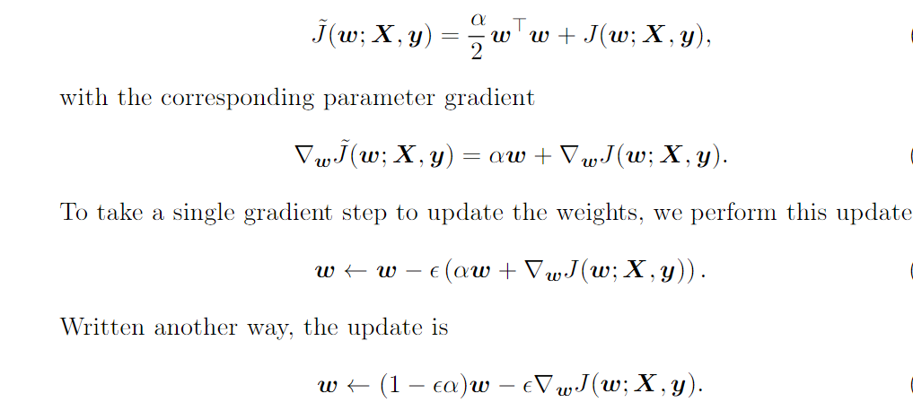
L² Parameter Regularization
One of the simplest and most common kind of parameter norm penalty is L² parameter & it’s also called commonly as weight decay
This regularization strategy drives the weights closer to the origin by adding a regularization term Ω(θ)= ½ w ½
L2 regularization is also known as ridge regression or Tikhonov regularization.
To simplify, we assume no bias parameter, so θ is just w. Such a model has the following total objective function

Slide 30

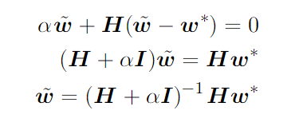
L² Parameter Regularization
We can see that the addition of the weight decay term has modiﬁed the learning rule to multiplicatively shrink the weight vector by a constant factor on each step, just before performing the usual gradient update. This describes what happens in a single step.
The approximation ^J is Given by
Where H is the Hessian matrix of J with respect to w evaluated at w∗.
The minimum of ˆJ occurs where its gradient ∇wˆJ(w) = H(w − w∗) is equal to ‘0’
To study the eﬀect of weight decay,
As α approaches 0, the regularized solution ˜w approaches w*. But what happens as α grows? Because H is real and symmetric, we can decompose it into a diagonal matrix Λ and an orthonormal basis of eigenvectors, Q, such that H = QΛQ^{T}

Slide 31
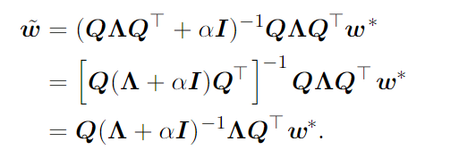
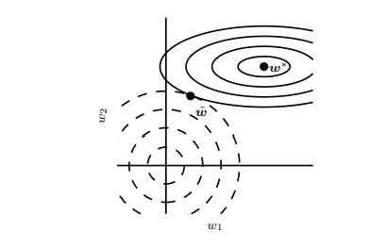
L² Parameter Regularization
Applying Decomposition to the above equation, We Obtain
The solid ellipses represent contours of equal value of the unregularized objective. The dotted circles represent contours of equal value of the L 2 regularizer. At the point w˜, these competing objectives reach an equilibrium. In the first dimension, the eigenvalue of the Hessian of J is small. The objective function does not increase much when moving horizontally away from w∗ . Because the objective function does not express a strong preference along this direction, the regularizer has a strong effect on this axis. The regularizer pulls w1 close to zero. In the second dimension, the objective function is very sensitive to movements away from w∗ . The corresponding eigenvalue is large, indicating high curvature. As a result, weight decay affects the position of w2 relatively little.

Slide 32



L¹ Parameter Regularization
While L 2 weight decay is the most common form of weight decay, there are other ways to penalize the size of the model parameters. Another option is to use L 1 regularization.
L 1 regularization on the model parameter w is defined as
as the sum of absolute values of the individual parameters.
L 1 weight decay controls the strength of the regularization by scaling the penalty Ω using a positive hyperparameter α. Thus, the regularized objective function J˜(w; X, y) is given by
with the corresponding gradient as
Eq-1

Slide 33

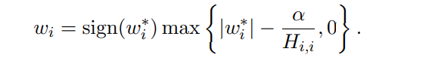
L¹ Parameter Regularization
By inspecting equation 1, we can see immediately that the effect of L 1 regularization is quite different from that of L 2 regularization. Specifically, we can see that the regularization contribution to the gradient no longer scales linearly with each wi ; instead it is a constant factor with a sign equal to sign(wi).
Quadratic approximation of the L 1 regularized objective function decomposes into a sum over the parameters
The problem of minimizing this approximate cost function has an analytical solution with the following form:

Slide 34
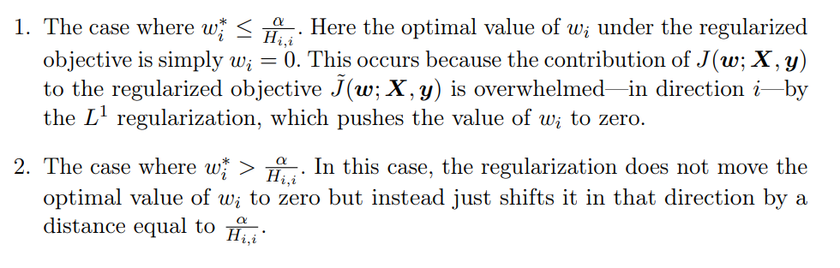
L¹ Parameter Regularization
Consider the situation where w ∗ i > 0 for all i. There are two possible outcomes:

Slide 35
Difference between L^{1 &} L² Parameter Regularization
L1 regularization attempts to estimate the median of data, L2 regularization makes estimation for the mean of the data in order to evade overfitting.
L1 regularization can add the penalty term in cost function. But L2 regularization appends the squared value of weights in the cost function.
L1 regularization can be helpful in features selection by eradicating the unimportant features, whereas, L2 regularization is not recommended for feature selection
L1 doesn’t have a closed form solution since it includes an absolute value and it is a non-differentiable function, while L2 has a solution in closed form as it’s a square of a weight

Slide 36
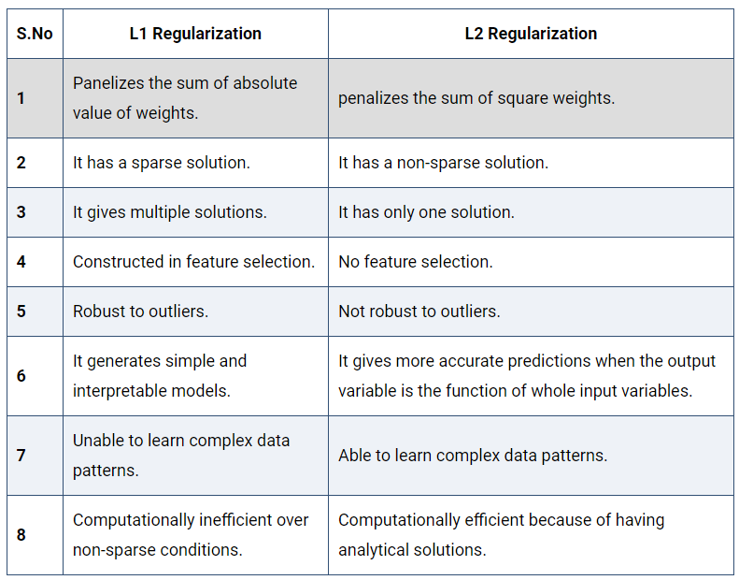
Difference between L^{1 &} L² Parameter Regularization

Slide 37
SECA4002 – DEEP LEARNING NEURAL NETWORKS
Detailed Syllabus:
UNIT 2: DEEP NETWORKS
History of Deep Learning- A Probabilistic Theory of Deep Learning- Backpropagation and regularization, Batch normalization- VC Dimension and Neural Nets-Deep Vs Shallow Networks Convolutional Networks- Generative Adversarial Networks (GAN), Semi-supervised Learning

Slide 38
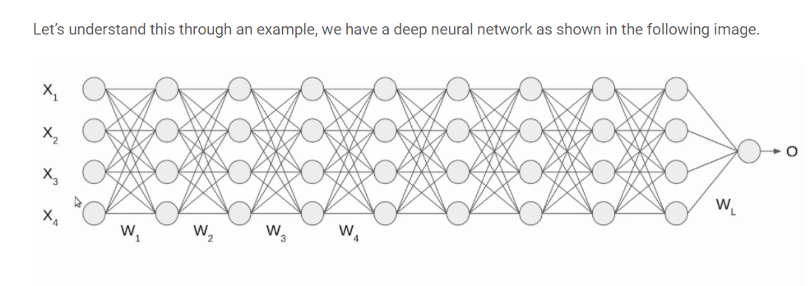
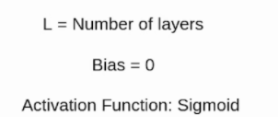
Batch Normalization
It is a method of adaptive reparameterization, motivated by the difficulty of training very deep models.
In Deep networks, the weights are updated for each layer. So the output will no longer be on the same scale as the input (even though input is normalized).
Normalization - is a data pre-processing tool used to bring the numerical data to a common scale without distorting its shape.
when we input the data to a machine or deep learning algorithm we tend to change the values to a balanced scale because, we ensure that our model can generalize appropriately.(Normalization is used to bring the input into a balanced scale/ Range)
Image Source: https://www.analyticsvidhya.com/blog/2021/03/introduction-to-batch-normalization/

Slide 39
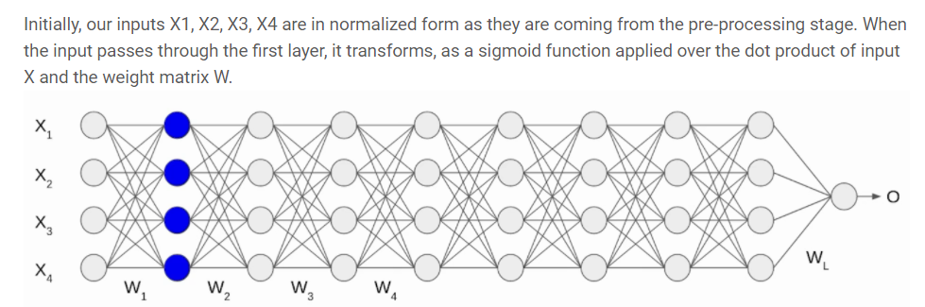

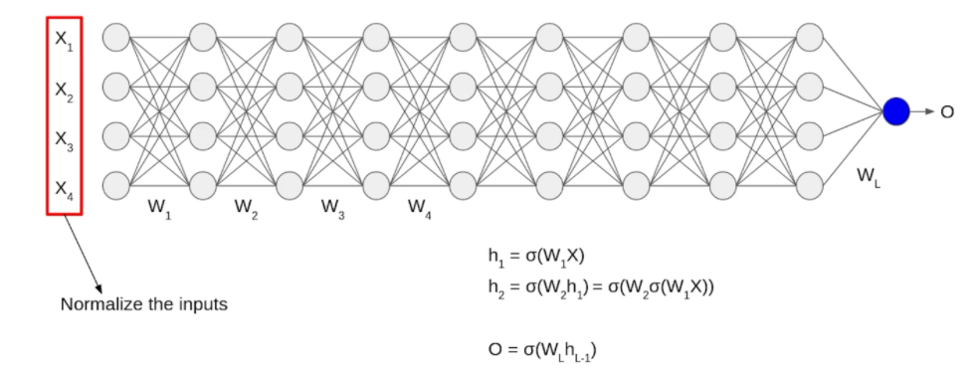
Batch Normalization
Image Source: https://www.analyticsvidhya.com/blog/2021/03/introduction-to-batch-normalization/

Slide 40

Batch Normalization
Even though the input X was normalized but the output is no longer on the same scale.
The data passes through multiple layers of network with multiple times(sigmoidal) activation functions are applied, which leads to an internal co-variate shift in the data.
This motivates us to move towards Batch Normalization
Normalization is the process of altering the input data to have mean as zero and standard deviation value as one
Procedure to do Batch Normalization:
(1) Consider the batch input from layer h, for this layer we need to calculate the mean of this hidden activation.
Where n - number of neurons in the hidden layer h
Image Source: https://www.analyticsvidhya.com/blog/2021/03/introduction-to-batch-normalization/

Slide 41
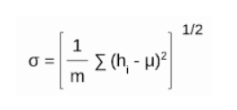


Batch Normalization (BN)
(2) After calculating the mean the next step is to calculate the standard deviation of the hidden activations.
(3)cNow we normalize the hidden activations using these Mean & Standard Deviation values.
To do this, we subtract the mean from each input and divide the whole value with the sum of standard deviation and the smoothing term (ε).
(4) As the final stage, the re-scaling and offsetting of the input is performed. Here two components of the BN algorithm is used, γ(gamma) and β (beta). These parameters are used for re-scaling (γ) and shifting(β) the vector contains values from the previous operations.
These two parameters are learnable parameters, Hence during the training of neural network, the optimal values of γ and β are obtained and used. Hence we get the accurate normalization of each batch.
All equations are adopted from:https://www.analyticsvidhya.com/blog/2021/03/introduction-to-batch-normalization/

Slide 42
SECA4002 – DEEP LEARNING NEURAL NETWORKS
Detailed Syllabus:
UNIT 2: DEEP NETWORKS
History of Deep Learning- A Probabilistic Theory of Deep Learning- Backpropagation and regularization, Batch normalization- VC Dimension and Neural Nets-Deep Vs Shallow Networks Convolutional Networks- Generative Adversarial Networks (GAN), Semi-supervised Learning

Slide 43
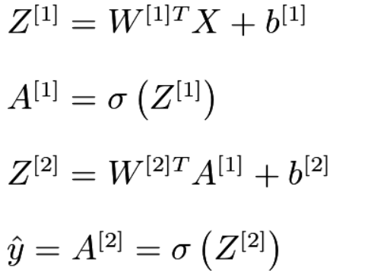
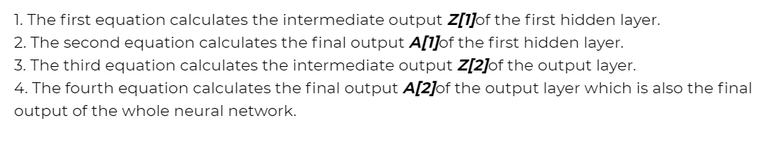
Shallow Networks
Shallow neural networks give us basic idea about deep neural network which consist of only 1 or 2 hidden layers. Understanding a shallow neural network gives us an understanding into what exactly is going on inside a deep neural network A neural network is built using various hidden layers. Now that we know the computations that occur in a particular layer, let us understand how the whole neural network computes the output for a given input X. These can also be called the forward-propagation equations.

Slide 44
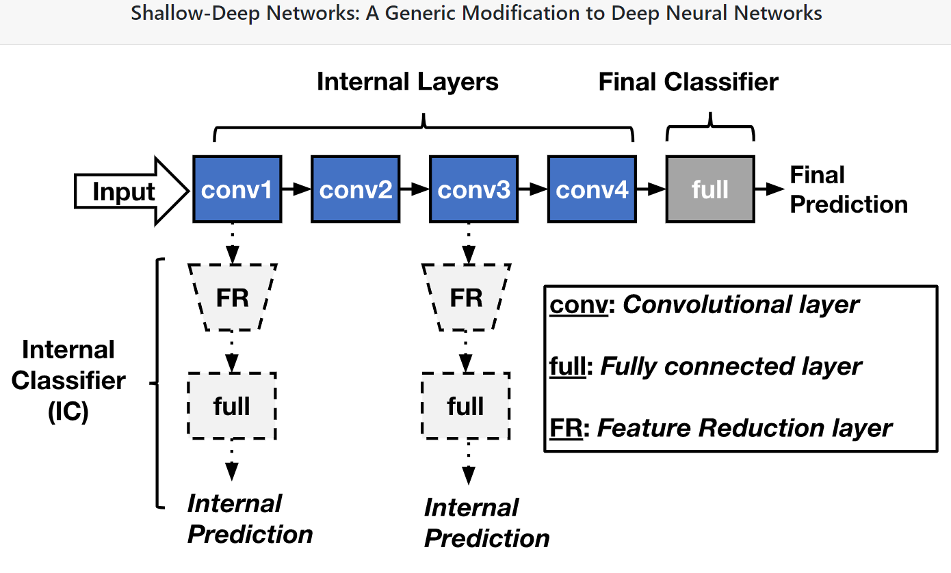
Shallow Networks

Slide 45
Shallow Networks
Difference Between a Shallow Net & Deep Learning Net:
Sl.No | Shallow Net’s | Deep Learning Net’s
1 | One Hidden layer(or very less no. of Hidden Layers) | Deep Net’s has many layers of Hidden layers with more no. of neurons in each layers
2 | Takes input only as VECTORS | DL can have raw data like image, text as inputs
3 | Shallow net’s needs more parameters to have better fit | DL can fit functions better with less parameters than a shallow network
4 | Shallow networks with one Hidden layer (same no of neurons as DL) cannot place complex functions over the input space | DL can compactly express highly complex functions over input space
5 | The number of units in a shallow network grows exponentially with task complexity. | DL don’t need to increase it size(neurons) for complex problems
6 | Shallow network is more difficult to train with our current algorithms (e.g. it has issues of local minima etc) | Training in DL is easy and no issue of local minima in DL

Slide 46

Dr. V. Vedanarayanan B.E., M.E., PhD
Assistant Professor, Department of ECE,
School of Electrical and Electronics
Sathyabama Institute of Science and technology
Vedanarayanan.etc@sathyabama.ac.in
This Photo by Unknown Author is licensed under CC BY

